Slide 1
Special Interest Group Launch: Green IP

Slide 2
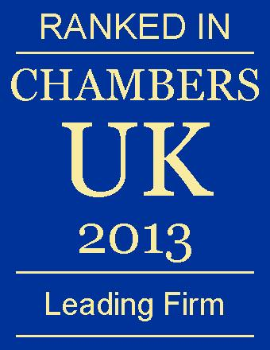
J A Kemp: General Introduction
“Commentators praise J A Kemp’s partners for their ‘intelligence, creativity and ingenuity’, and are delighted with the consistently high quality of their work.”
^{Chambers & Partners}
“J A Kemp’s patent group provides timely and succinct advice and its technical and professional expertise is completely comprehensive.”
^{The Legal 500}
“J A Kemp’s boasts one of the UK’s most highly qualified collections of attorneys”
^{Managing Intellectual Property}

Slide 3
Attorneys and Lawyers
Biotechnology and Life Sciences Group |  | Chemistry and Pharmaceuticals Group |  | Engineering and IT Group
Attorneys | Trainees and Part Qualified Attorneys | Attorneys | Trainees and Part Qualified Attorneys | Attorneys | Trainees and Part Qualified Attorneys
Patrick Campbell | Dr Vicki Allen | John Benson | Dr Sophie Evans | Mike Nicholls | Dr Greg Ward
Simon Wright | Dr Huw Jenkins | Celia Keen | Guy Brain | Nigel Price | Hermione Thompson
Geoff Woods | Dr Emily Barker | Dr Tim Duckworth |  | John Leeming | Joseph Brown
Sarah Roques | Dr Kapil Tuladhar | Ravi Srinivasan |  | Samuel Smith | Edward Thien
Andrew Bentham | Dr Lucy Williams | Gail McCluskie |  | Colin Merryweather
Dr Pamela Tuxworth |  | Amanda Simons |  | Mark Roberts
Jane Sexton |  | Dr Stuart Raynor |  | Dr Martin Jackson
Dr David Power |  | Dr Peter Silcock |  | Toby Hopkin
Dr Hazel Ford |  | Dr Jenny Chewter |  | Steve Unwin
Dr Lee Chapman |  | Kieron Grehan |  | Dr Robin Tyson
Dr Joanne Roberts |  | Dr Simon Turberville |  | Dr Dominic Forsythe
Dr Graham Lewis |  | Chris Milton |  | Dr Janet Perkins
Dr Jimmy Nicholls |  | Dr Andrew Clark |  | Dr Dan Cooney
Dr Anna Gregson |  | Alastair Newman |  | James Main
 |  | Tom Lease
Trade Marks and Designs Group
Attorneys
James Fish |  | Lawyers
John Leeming
Toby Hopkin |  | Andrew Webb
Tom Albertini |  | James Fish
Ben Mooneapillay |  | Rosalind Miller
Charlotte Stirling |  | Kerry Fitchett
Rosalind Miller

Slide 4
J A Kemp: General Introduction
UK top six Patent Attorney practice based on total number of patent attorneys and trainee patent attorneys
>50 attorneys and trainee attorneys and 20 paralegal or semi-chargeable staff
In-depth understanding of all technology areas (>25 PhDs in the firm)
In 2012, we filed more than 1200 European patent applications
Client base comprises a balance of technology transfer organisations, research organisations, startups, spinouts and SMEs and multinational corporations
Highly experienced in oppositions and appeals before the European Patent Office
The firm is structured in four client service groups – Biotechnology & Life Sciences, Chemistry & Pharmaceuticals, Engineering & IT and Trade Marks & Designs - each having the depth and breadth of knowledge to deal with matters extending across disciplines

Slide 5
J A Kemp: Cleantech Sector Specialism
Our Cleantech sector specialism stretches across all client service groups, and all types of client
We deal with inventions in areas as diverse as fuel cells, renewable energy generation (in particular wind and wave energy, solar power and bio-reactors), biofuels, recycling, water treatment and combustion engine management.
We have practical experience of using the UK-IPO "Green Channel" to accelerate the examination of UK patent applications relating to clean or green technology, and in-depth knowledge of worldwide equivalents. As part of our commitment to Cleantech clients we do not apply any service charges for requesting combined search and examination and entry into the Green Channel at the UK IPO.
J A Kemp has its own environmental policy and carbon reduction programme, supported by rigorous data collection and monitoring. The firm's commitment to managing its environmental impact specifically by reducing its carbon footprint has been recognised through certification of its programme by Carbon Smart.

Slide 6
Cleantech Group – Public Record Clients

Slide 7
INDEPENDENT THINKING • COLLECTIVE EXCELLENCE

