Slide 1
London Demand Response

Slide 3
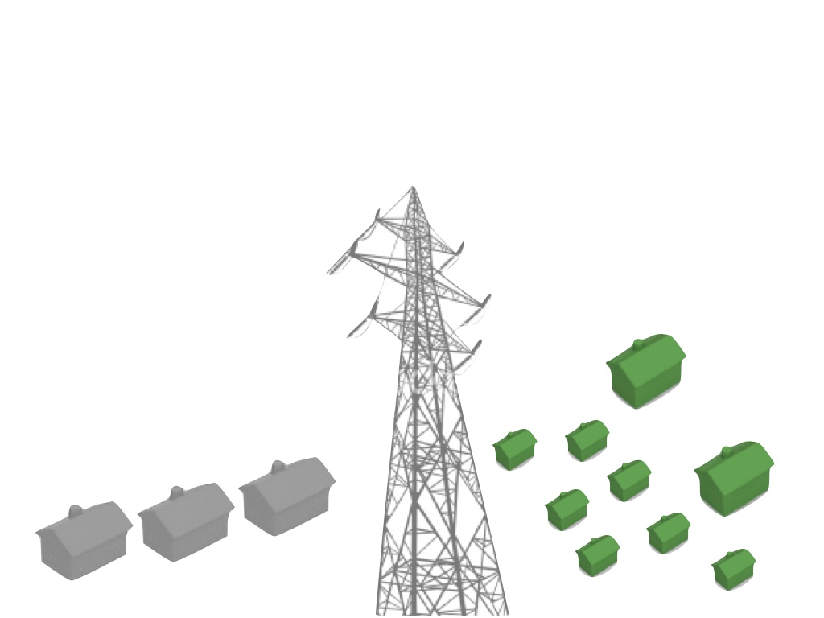
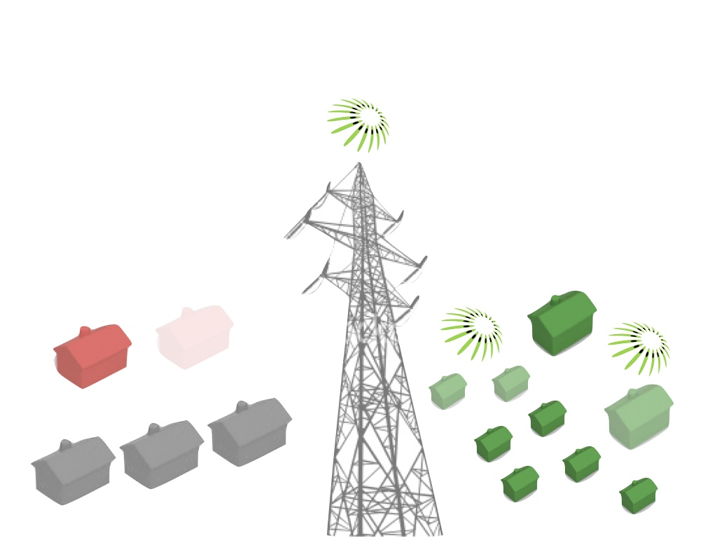
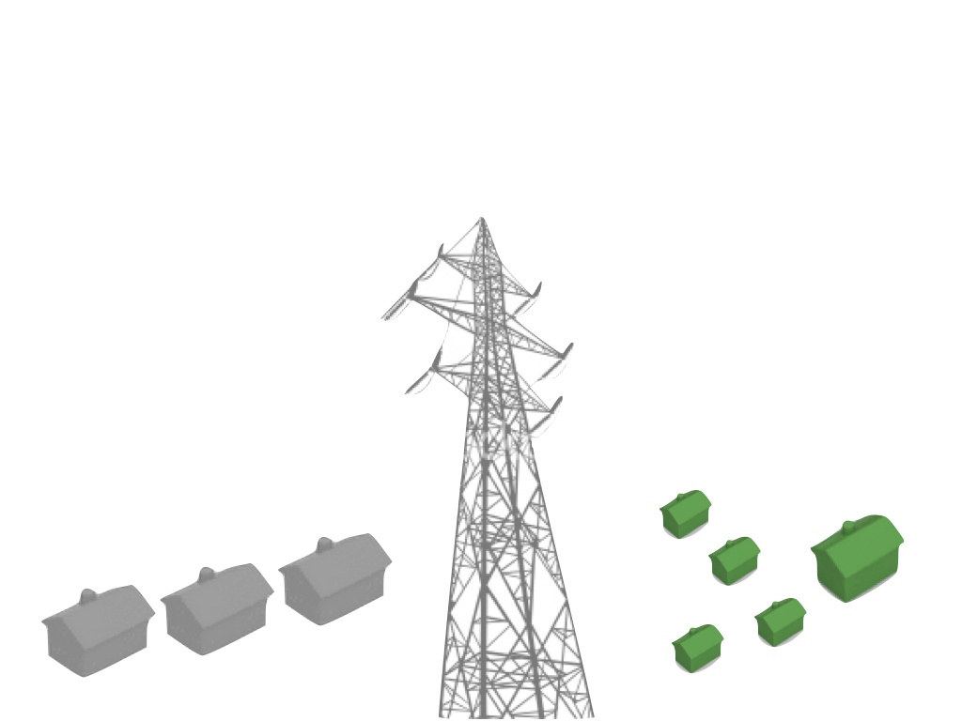
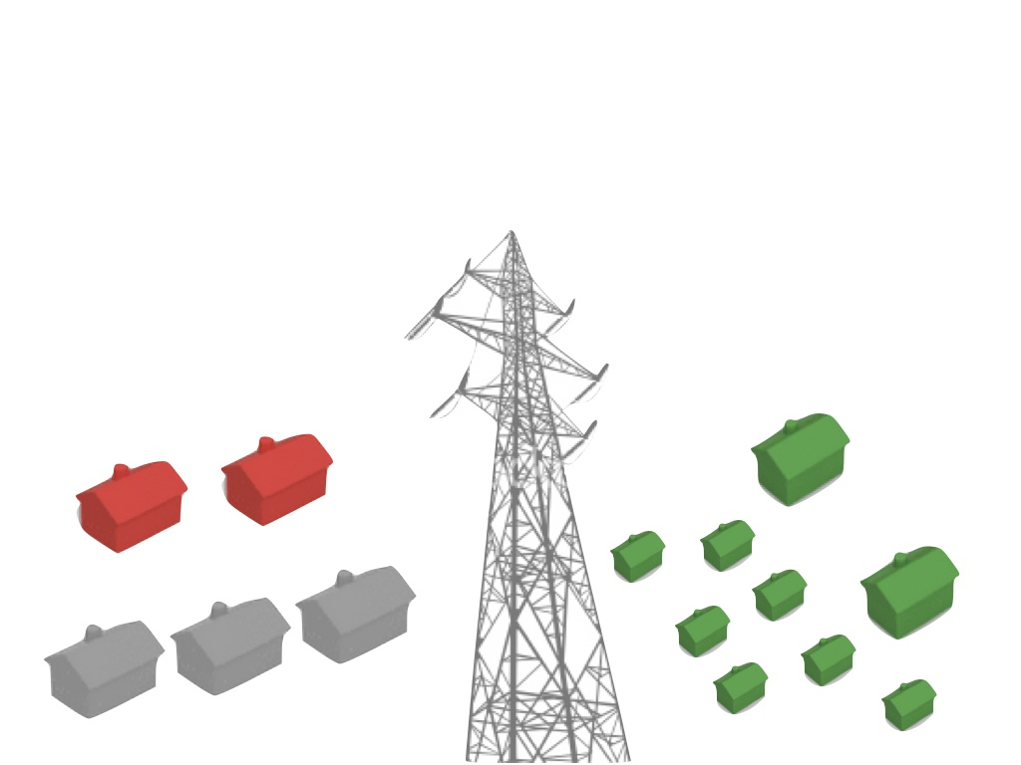

Slide 5
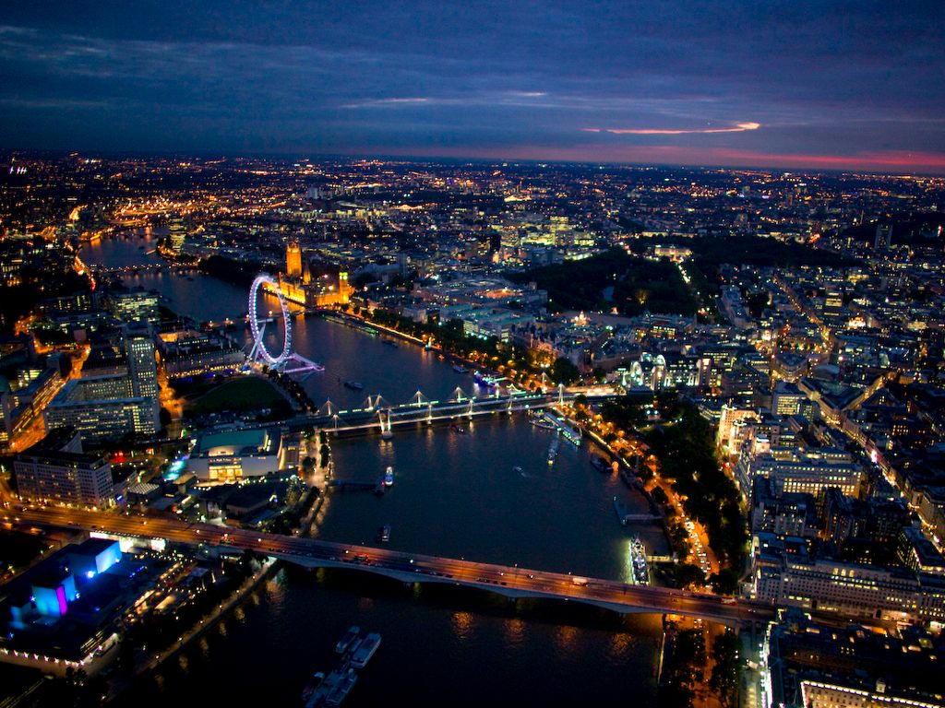

Slide 7
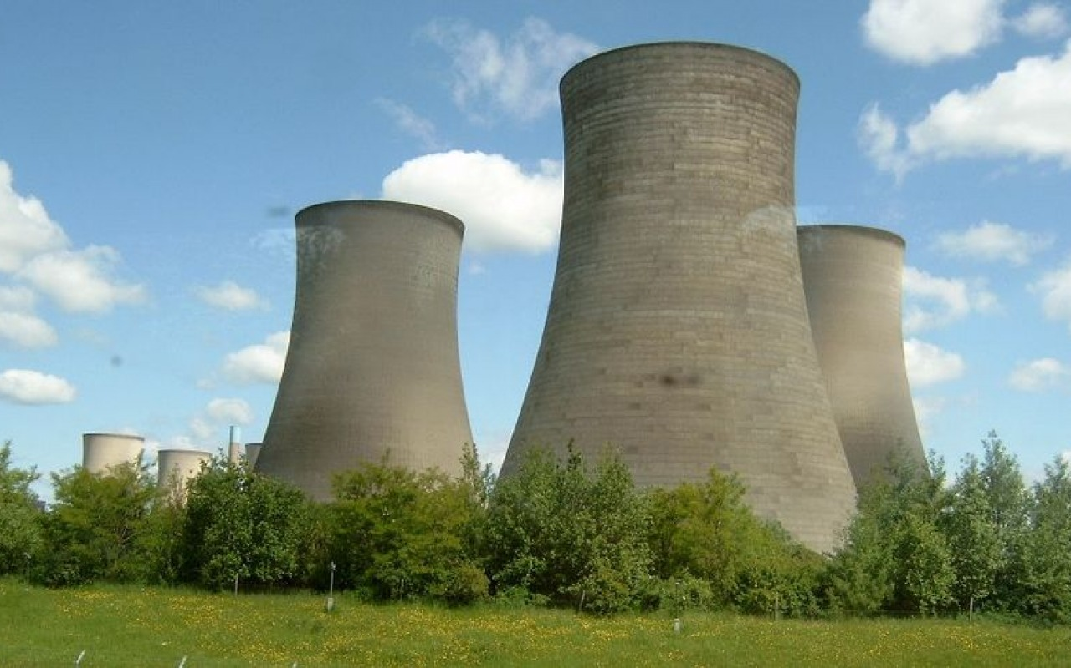
25%
capacity shutting down
Didcot Power Station closed March 2013
2000 MW

Slide 8
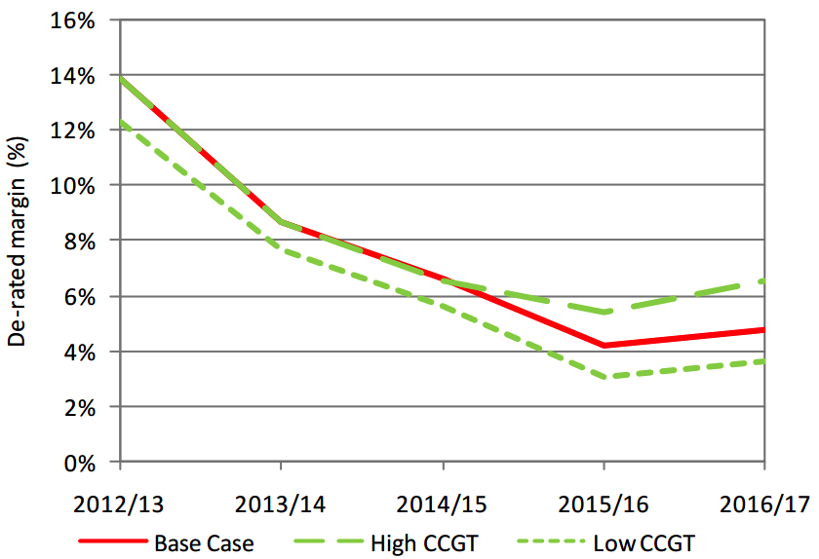
Ofgem Capacity Forecast
2010/11 | 2011/12 | 2012/13 | 2013/14 | 2014/15 | 2015/16 | 2016/17
0% | 0.8% | 0.2% | 1.5% | 1.9% | 2.0% | 2.2%

Slide 9
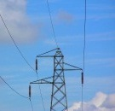
Demand Response Benefits
 | Financial Benefits: Participation in energy demand response contracts can generate significant annual benefits
 | Green Performance: Provide further improvements to environmental performance
 | Reduce CO₂: Participants immediately help make the UK electricity network less carbon intensive and greener
 | No Cost: There is no cost to participants or any interruption to service

Slide 10
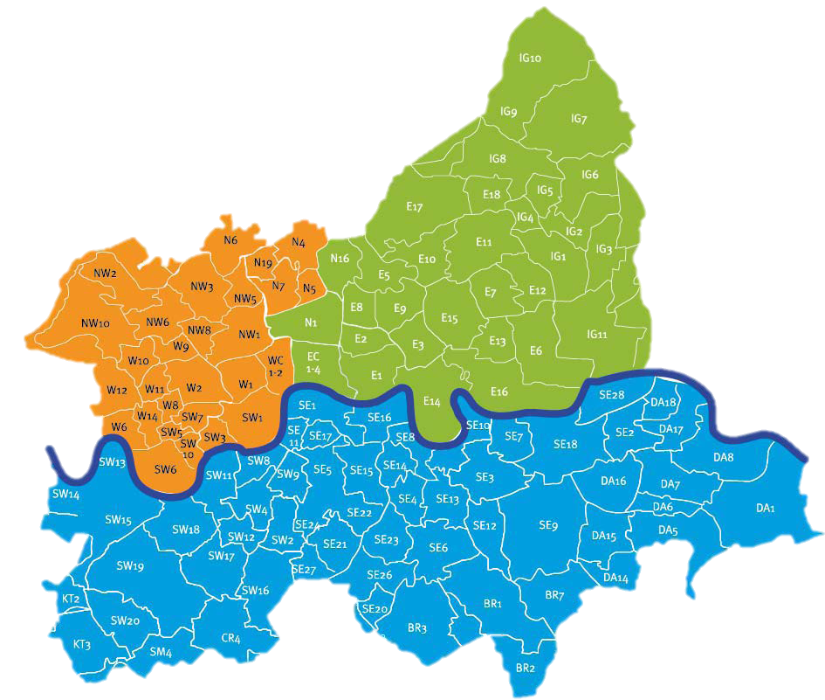
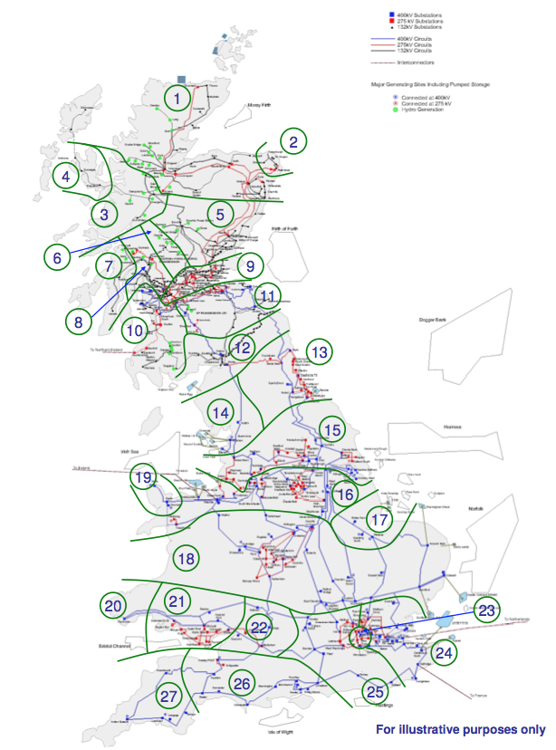

Slide 11
Active Network Management
UK Power Networks
Low Carbon Network Fund
London constrained substations
£1.8 billion network reinforcement over 5 years

Slide 12
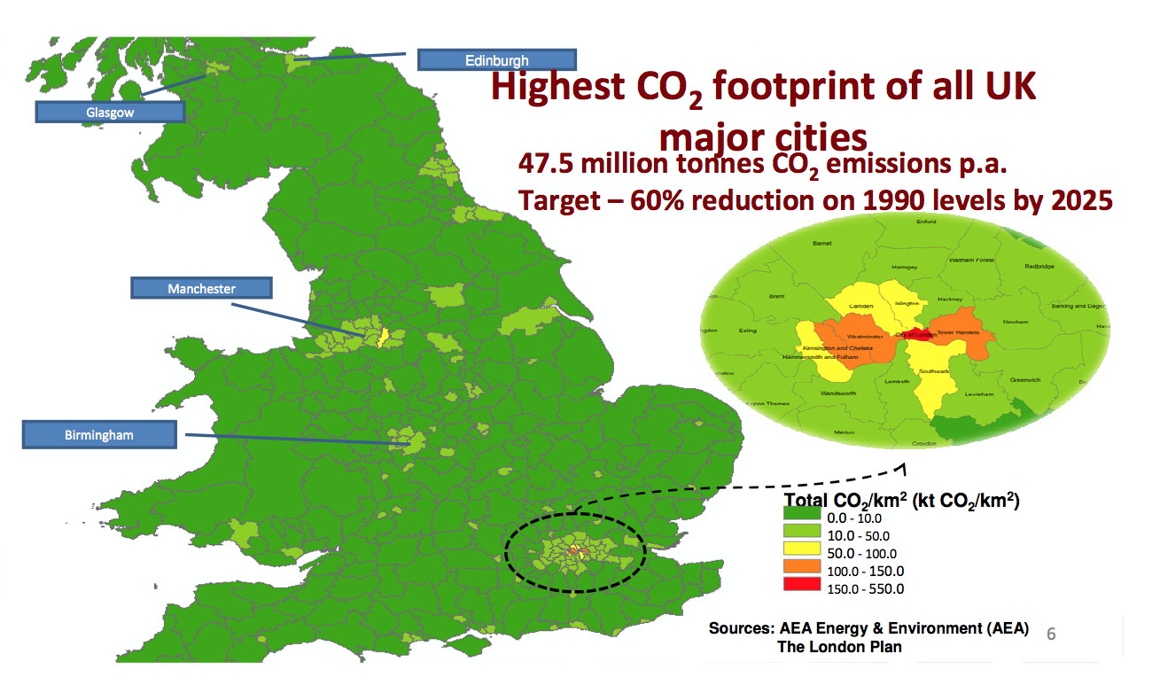

Slide 13
Active Network Management
Demand Response within the M25
Chillers, pumps, lighting, HVAC, fans
CHP
Generators
£70,000 per MW
Get in touch with us now to participate!

Slide 15
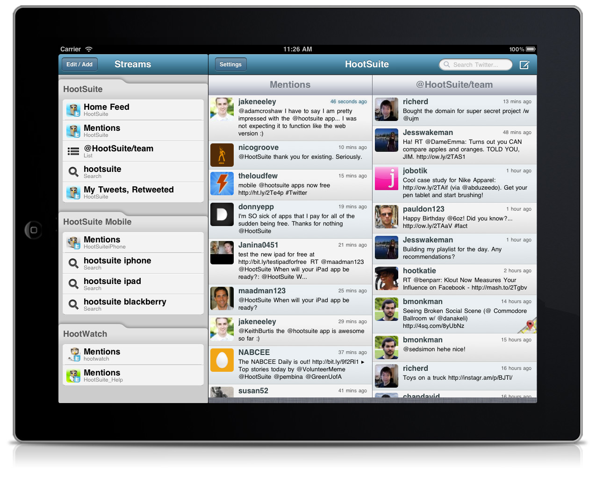
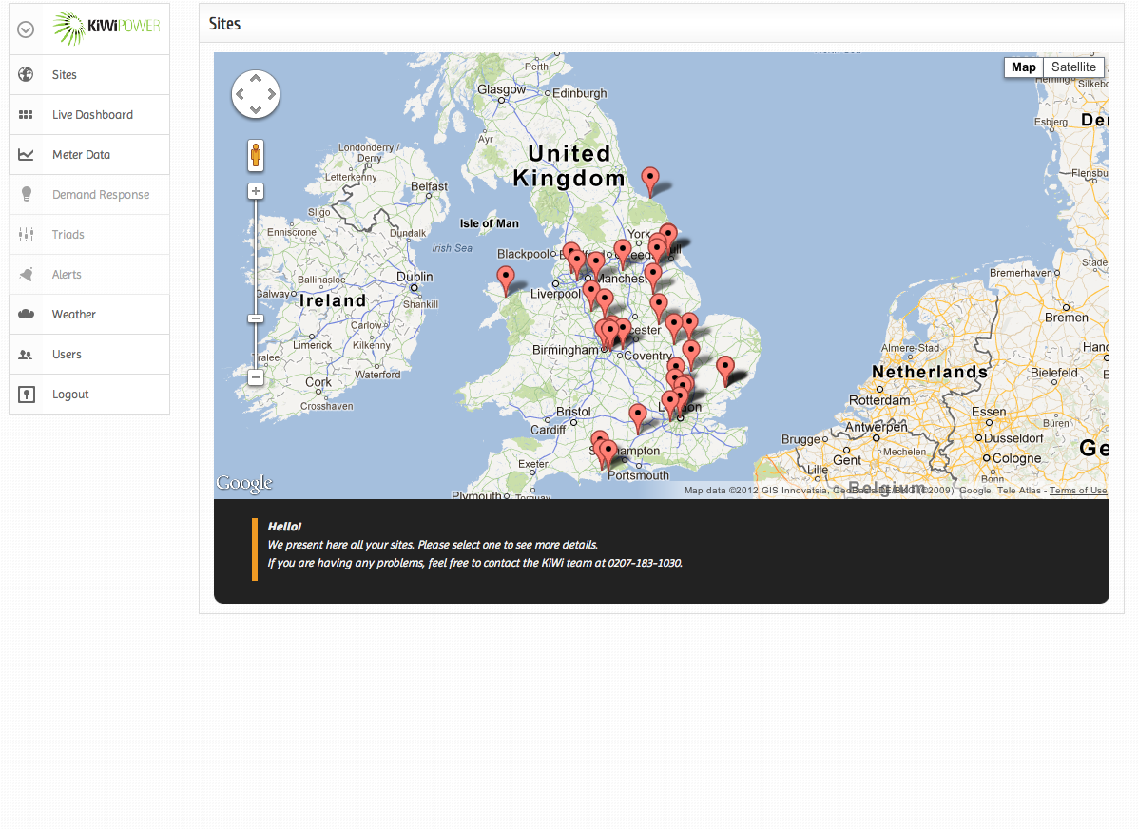

Slide 16
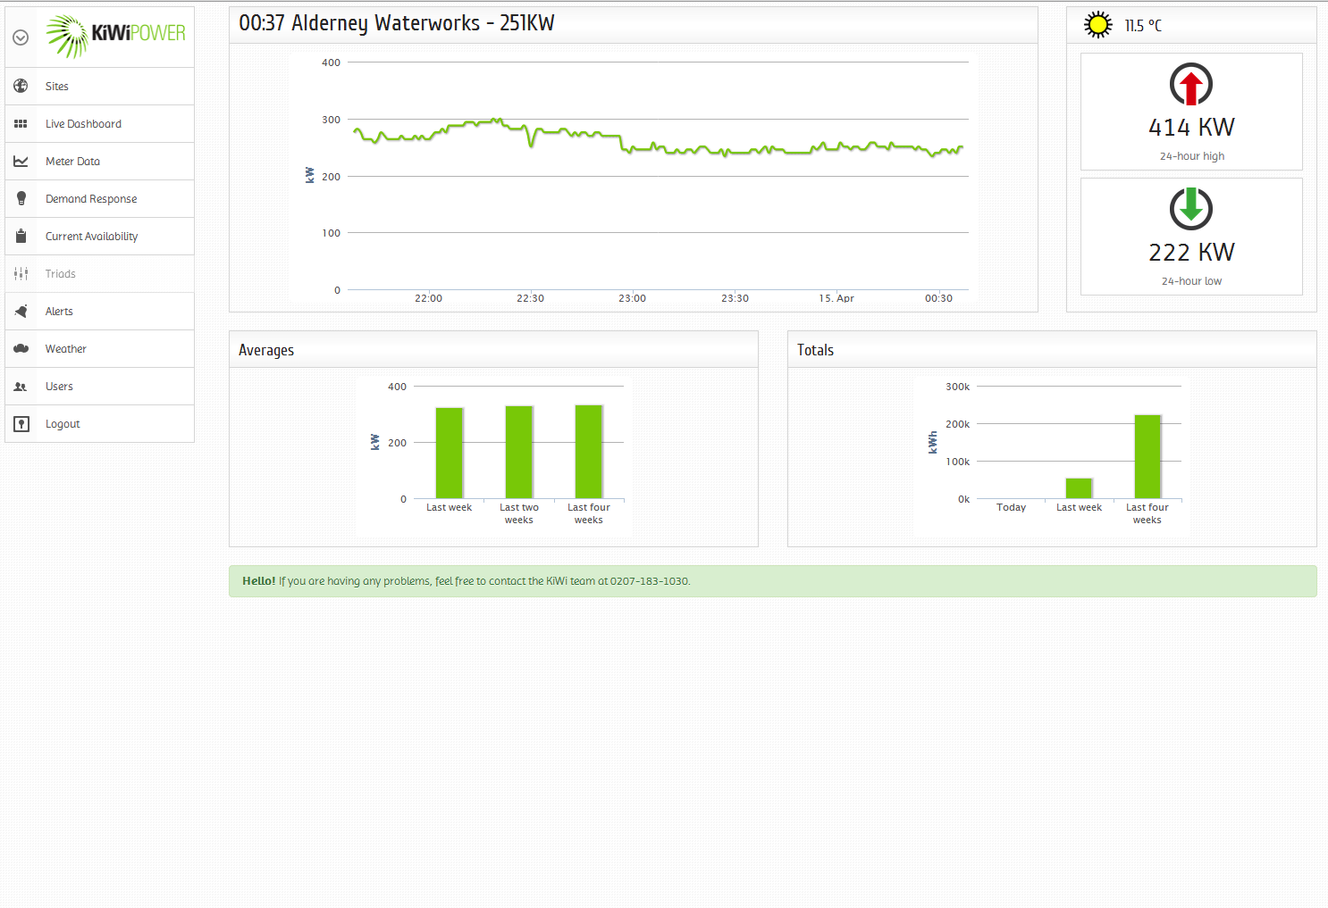

Slide 17
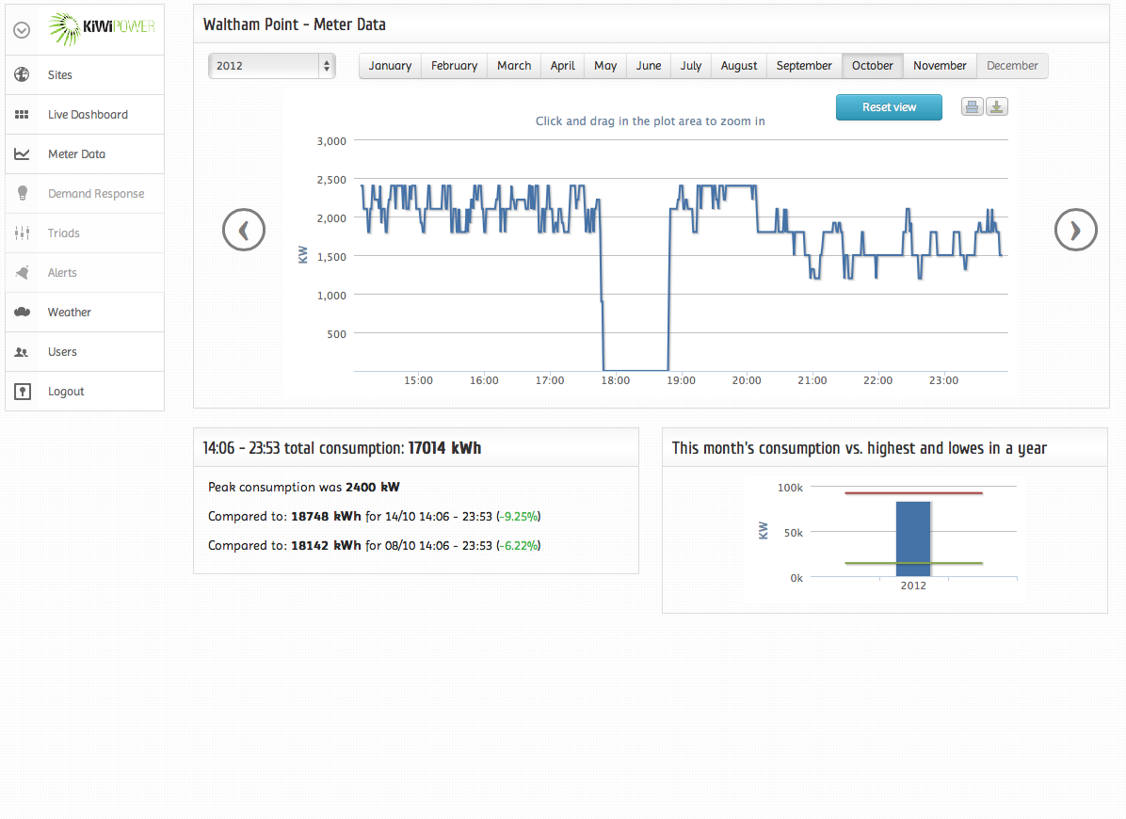

Slide 18
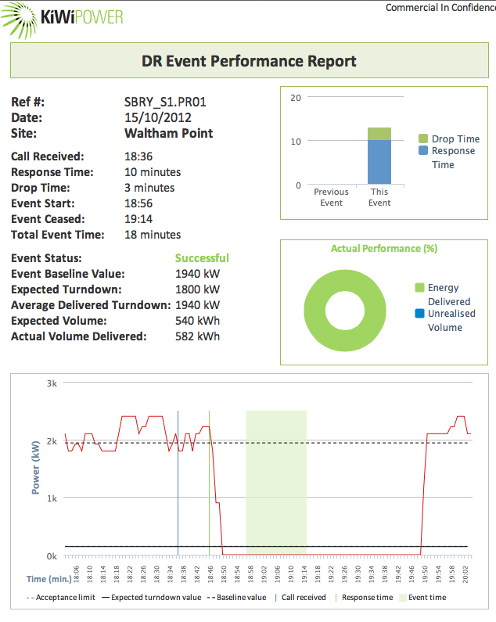

Slide 19
Selected Customers
Commercial
Industrial
Institutional

Slide 20
About KiWi Power & Next Steps
Founded in 2009
London-based, International Focus
25 member team
Commercialise the DR market
ISO 9001, 14001, 18001
Immediate opportunities in London
June to August: Active Network Management
November to February: Triad Management
All year: Demand Response

