Slide 1
Notes:
Now I’m going to be presenting to you about the LCRN network, the role we play in procuring green and how you can get involved.

Slide 2
London’s Waste
11.5% unemployment
20 million tons of waste
1.5 million reusable items discarded
Homelessness & poverty
Poor environmental quality
Empty shops & commercial premises
High levels of reoffending
Notes:
Right now, here’s a snapshot of what’s going on in London. This is what some see as London’s ‘waste’.

Slide 3
London’s Resources
250,000 people available (11.5% unemployment!)
20 million tons of resource (waste?!)
1.5 million reusable items to be collected and redistributed (not discarded!)
Thriving social enterprise hub
Wide reaching voluntary, community sector
Notes:
We’re proposing a new way of looking at ‘waste’. Let’s look at ‘waste’ as a resource. We’ve got people, we’ve got resources – there’s a way to restructure our system in order to take advantage of this. LCRN is currently putting in a bid to the London Waste and Recycling Board for the creation of a London-wide reuse network. This would entail the creation of several reuse hubs across London that will be able to collect anything and everything from anywhere. Items would then either be refurbished for further sale, sent to Housing Associations of Halls of Residence for use or dismantled for parts. We would employ people who were out of work and create special refurbishment training courses for those that would benefit from qualifications and certification.

Slide 4
Sustainability London Community Resource Network
Notes:
This type of structure is based on the trifecta of benefits (I call it). It hits social, environmental and economic needs, creating jobs, communities and business support, all in the name of sustainability.

Slide 5
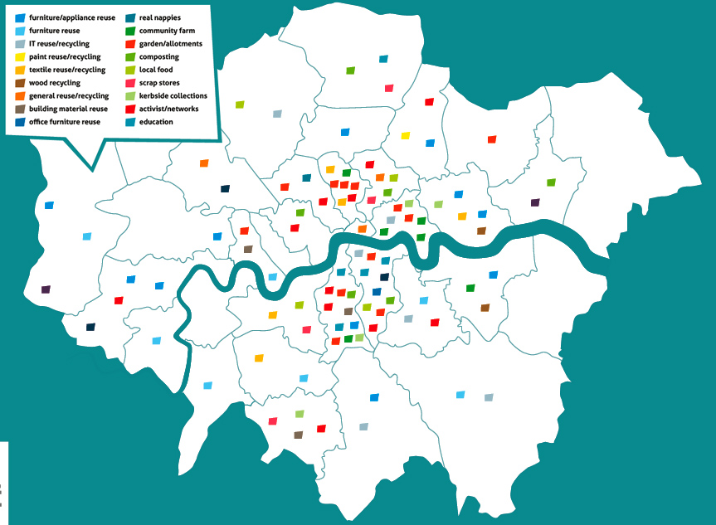
The Network social enterprises/ SMEs/ community organisations
Notes:
Here’s the latest map we have of the LCRN network. As you can see we’ve got quite a few organisations in central London, but we’re still working on the outer boroughs. I had a chat with LB Redbridge last week so we’re making progress.

Slide 6
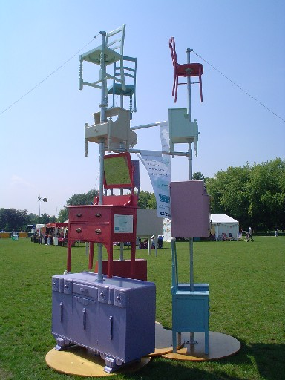
Services London Community Resource Network
WASTE MINIMISATION
information, awareness
environmental accreditation
waste and carbon audits
green IT services
office clearance / refurb / refit
REUSE – collecting & redistributing
office furniture
fixtures, fittings furnishings
building materials
RECYCLING collecting & processing
paper, card, metal, glass
food waste
Notes:
What do we do? These are some of the services we provide to the public via our members.

Slide 7
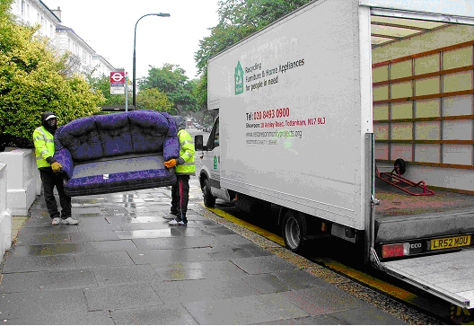
ReStore furniture reuse project
Restore is a furniture and appliance reuse enterprise, and will collect unwanted items at no charge
Technicians repair, refurbish and put them back on the market at affordable prices.
The project operates as social enterprises running training schemes and offering volunteering placements
Restore offers NVQ qualifications and the chance to develop a variety of skills
Notes:
I’m going to show you a couple case studies now. Restore is a furniture project located in Haringey, but they service several boroughs in the North London area. They’ve even provided furniture to Café Direct and Wayne Hemingway for a shipping container café they’re putting together for the summer, as well as furniture for the latest Harry Potter film (it got destroyed, sadly…)

Slide 8
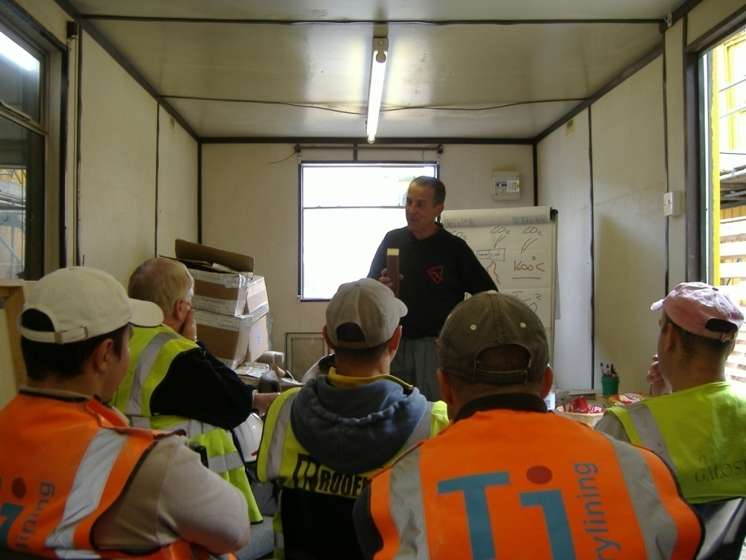
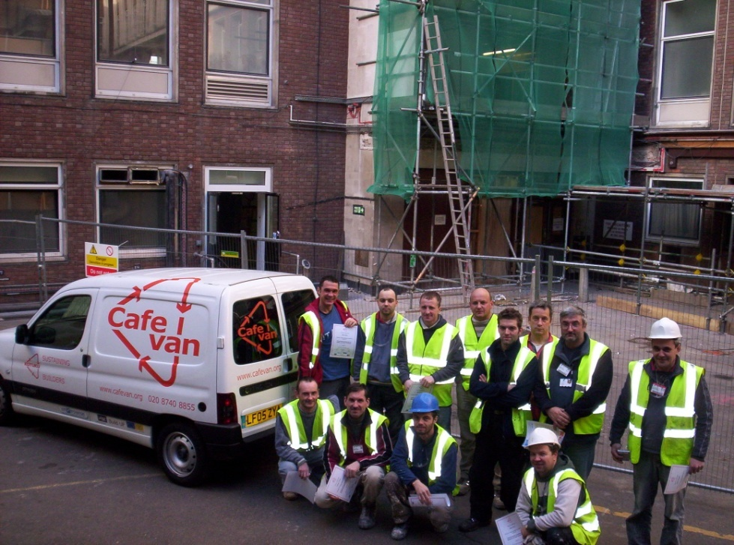
Kotuku – working with the construction industry
The kotuku ‘Cafe Van’ travels around building sites delivering short presentations on waste minimisation and recycling materials to site workers and managers, over drinks and sandwiches.
Kotuku run other training programmes for the construction industry including ‘the virtual skip’ and training for young site labourers.
Notes:
Kotuku are getting into the very hot field of construction waste. People don’t know that a good chunk of the waste that’s produced in the UK comes from construction and demolition, and builders would save loads of money if they were a bit more precious about their resources.

Slide 9
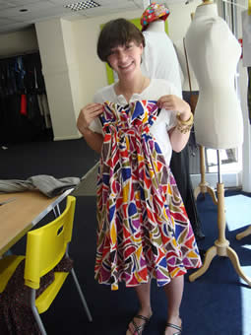
TRAID textile recycling and redesigning
Textile Recycling for Aid and International Development (TRAID) operates over 900 textile recycling banks across the UK.
The clothing is then sold back to the public in one of TRAID's shops or reconstructed and redesigned into new one-off pieces and sold under the recycled fashion label ‘TRAIDremade’.
Notes:
TRAID do clothing and textile recycling and reuse. You have probably seen one of their collection banks around town – they’ve been involved in a bit of conflict as there are a lot of other clothing collection groups either stealing their bins or potential customers. The thing is that these other guys send their textiles overseas for sorting b/c it’s cheaper, while TRAID do their sorting in the UK, providing jobs for people here. They also do some amazing design work and sell reworked clothing under the label TRAIDremade.

Slide 10
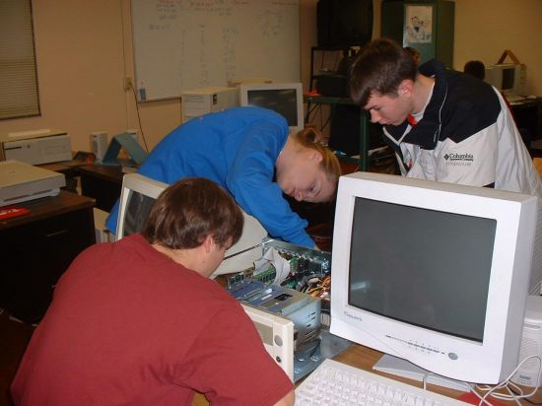
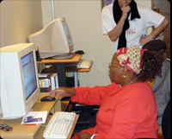
crispej@aol.com www.crispej.org.uk 020 7703 5222
Offers / Ex-IT
Offers/Ex-IT computer and office
equipment reuse and recycling
(SOUTHWARK)
Computer refurbishment, technical
training
Office and administration volunteering
posts
Weekly capacity varies
DigiBridge
DigiBridge serves SMEs while helping to transform communities:
Assists excluded individuals and households to become computer literate and to gain access to the knowledge economy
Provide cost effect ICT support to Voluntary, Community sector organizations (VCSO) and Small & Medium sized Enterprises (SMEs).
diye@digibridge.co.uk digibridge.co.uk 020 7650 8703
Notes:
These are some of our computer and electronics reuse groups. Offers/Ex-IT are based in south London and do more equipment based work, while Digibridge do more education and service-based work. You’ll be hearing from Computer Aid International shortly, who will be presenting on the amazing work they do with computers and international development.

Slide 11
London Community Resource Network
www.lcrn.org.uk
Twitter: @LCRNnews
020 7324 4702
mike@lcrn.org.uk
Subscribe to our weekly newsletter!

